Slide 1
LECTURE I
Introduction to Data and Information Management 1

Slide 2
Objectives
Data, Information and its relevance
Review earlier data management approach
File based systems and their challenges
Examine the database approach
Major components of DBMS.
Advantages and disadvantages of DBMS’s
ANSI-SPARC 3 Level Database Architecture
Data Model
Database System Development Lifecycle

Slide 3
Data vs. Information
0
Data
Data are raw, unprocessed facts with no purposeful meaning.
Data is represented by symbols such as letters of the alphabets, numerals or other special symbols.
Information
Data that has been processed into a meaningful form.
value-added to data
Summarized
Organized
analyzed

Slide 4
Data and Information - Relevance
With data, information can be generated
With the right, accurate and relevant information, Individuals or organizations cab be able to;
Make Informed decisions
React to internal and external environment
The relevance of data and information compels individuals or organizations to manage it using various means.
…….

Slide 5
Data and Information Management
Data and information are increasingly recognized as enterprise assets.
Data and information management is …
the development, execution and supervision
of plans, policies, programs
that control, protect, deliver and enhance the value of data and information assets.
Definition: Data and Information Management is the practice of putting into place policies, procedures, and best practices that ensure that data is understandable, trusted, visible, accessible, optimized for use, and interoperable.

Slide 6


Manual Filing systems
A manual file is set up to hold all external and internal correspondence about a given subject e.g. bills, project
Notes:
A manual file is set up to hold all external and internal correspondence about a given subject e.g. bills, project. Files are kept in cabinets which are locked to ensure security.
It works well when the data or number of items to be stored is small; as numbers increase, labels are utilized.
Works well on a large number of items which only require storage and retrieval.
Retrieval of data; is mainly sequential i.e. search begins from first entry or through an indexing system.
Limited processing of data i.e. answering complex queries that require data from different sources e.g. annual reports about sales was very difficult.

Slide 7
FILE-BASED APPROACH
Better alternative to manual filing systems.
A file is a collection of records which contain logically related data.
A system of files and collection of application programs manipulating them is a file-based system
With a file based approach each user defines and creates with a specific software the files he needs for a specific application
Collection of application programs that perform services for the end users (e.g. reports); each program defines and manages its own data.

Slide 8
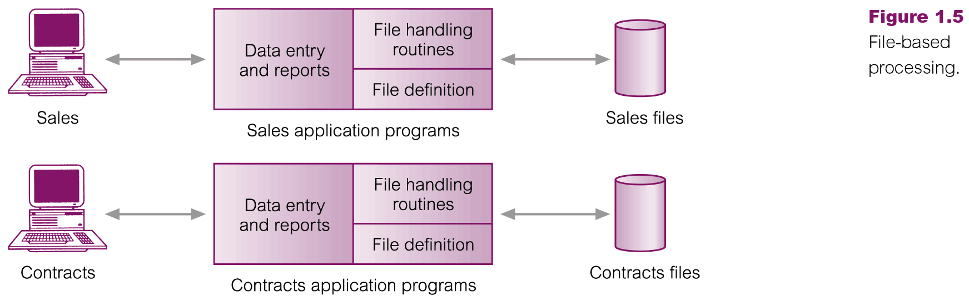
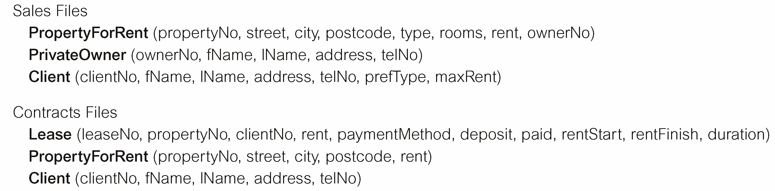
File-Based Processing
Notes:
With a file based approach each user defines and creates with a specific software the files he needs for a specific application

Slide 9
LIMITATIONS OF FILE-BASED APPROACH
Separation and isolation of data
Each program maintains its own set of data.
Users of one program may be unaware of potentially useful data held by other programs.
Duplication of data
Same data is held by different programs.
Wasted space and potentially different values and/or different formats for the same item.

Slide 10
LIMITATIONS OF FILE-BASED APPROACH
Incompatible file formats
Programs are written in different languages, and so cannot easily access each others files.
Fixed Queries/Proliferation of application programs
Programs are written to satisfy particular functions. Any new requirement needs a new program.
Data dependence
Unhealthy dependency between data and programs. The physical structure of data files is embedded in the application code. If some modifications have too be made in the data, the application program has to be rewritten.

Slide 11
LECTURE I PART 2
Introduction to the Database approach of managing Data

Slide 12
Database Approach
Databases were developed as a solution for the limitations of file based systems for data storage and management;
A database: A shared collection of logically related data, and a description of this data, designed to meet the information needs of an organization.
Why Databases are important
Efficient Manipulation of large data sets.
Integration of Multiple Data Sources
Notes:
Shared collection of logically related data

Slide 13
Examples of Database Applications
Purchases from the supermarket
Booking a holiday at the travel agents
Using the library
Taking out insurance
Renting a video
Amazon
Youtube

Slide 14
DATABASE TERMINOLOGIES
A database can be simply known as an organised collection of related data. Formally may be defined as a collection of related data, and a description of the data, designed to meet the information needs of an organisation.
Database Management System: A software system that enables users to define, create, and maintain the database and provides controlled access to this database.
Database application: A program that interacts with a database at some point in its execution.
Database applications access the database, process the data and generate the required information.

Slide 15
Examples of DBMS’s
MySQL
Oracle.
MS Access.
SQL server.
DB2.
File Maker
FoxPro

Slide 16
Characteristics of the Database approach
Single repository of data
sharable by multiple users, hence favorable for concurrency
Self-describing
System catalogue contains metadata (data defining other data).
Catalogue contain information about the definitions of the database objects (for example, tables, views) and security information about the type of access that users have to these objects.
Multiple views of data - to support individual needs of users.
View is a subset of a database tailored to the needs of a user.
Views provide some level of customization to the user

Slide 17
Characteristics of the Database approach cont’d
Program-data independence
Data independence is the notion of keeping data separate from all programs that make use of the data.
Data independence ensures that the data cannot be redefined or reorganized by any of the programs that make use of the data. In this approach, the data remains accessible, but is also stable and cannot be corrupted by the applications using it.
It refers to the immunity of user applications to make changes in the definition and organization of data

Slide 18
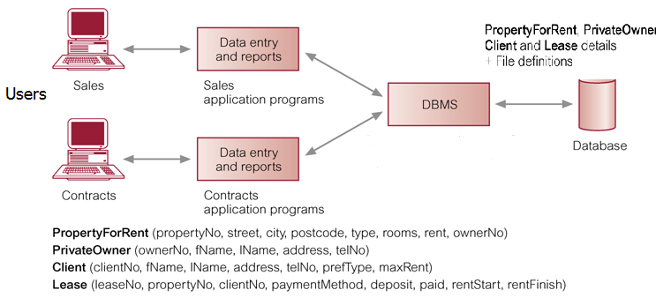
Database Management System (DBMS)

Slide 19
DBMS: Database Languages
Data definition language (DDL)
Permits specification of data types, structures and any data constraints that should be part of the database.
All specifications are stored in the database.
Data manipulation language (DML)
Enables those with access to the database to insert, update, delete and retrieve data from it.
Standard Query Language (SQL) is an example of a DDL & DML

Slide 20
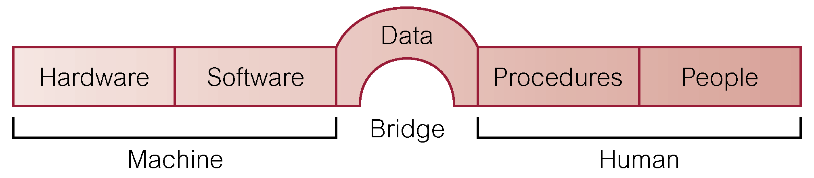
Components of DBMS Environment

Slide 21
Components of DBMS Environment
Hardware: refers to the physical parts of a computer and related devices. Can range from a PC to a network devices of computers.
Software: collection of programs used by the computers within the database system. DBMS, operating system, network software.
Procedures: Instructions and rules that should be applied to the design and use of the database and DBMS.
People: Users of the database system. Include; data administrator, database administrator, database designers, application programmers, and end-users.
Data: These are raw, unprocessed facts stored in the database. Data acts the bridge between the machine and human component

Slide 22
Advantages of DBMS
Control of data redundancy; DBMS help in integrating files and avoiding multiple copies of the same data.
Improved Security; The DBMS enforces integrity constraints
Increased concurrency; two or more users can access data at the same time without loss of data integrity.
Improved data accessibility and responsiveness; data crosses departments and unplanned questions can be asked.
Improved backup and recovery services; DBMS provides facilities of minimizing amount of processing that is lost following a failure.
Sharing of data; On the other hand the database belongs to the entire organization and can be shared by all authorized users.

Slide 23
Disadvantages of DBMS
Complexity: It has several components which need serious and careful planning to get a good DBMS.
Size: large size of software taking large disk space and memory.
Cost: DBMS, additional hardware e.g. Memory, conversion; costs of converting existing applications to run on the new DBMS and hardware, employing specialists, training staff etc.
Performance; some applications may not run as first as the used to because DBMS caters for several applications at once.
Higher impact of a failure; integration of resources increases vulnerability.

Slide 24
ANSI SPARC 3 LEVEL DATABASE ARCHITECTURE
One of the aim of a database system is to provide users with an abstract view of data, hiding certain details of how data is stored and manipulated.
Furthermore , A database is a shared resource , therefore different users might require different views of the same database.
Therefore to satisfy these needs , the architecture of most commercial DBMS is based on the ANSI-SPARC ARCHITECURE (American National Standard Institute Standard Planning and Requirements Committee)
Notes:
Architecture = structural design

Slide 25
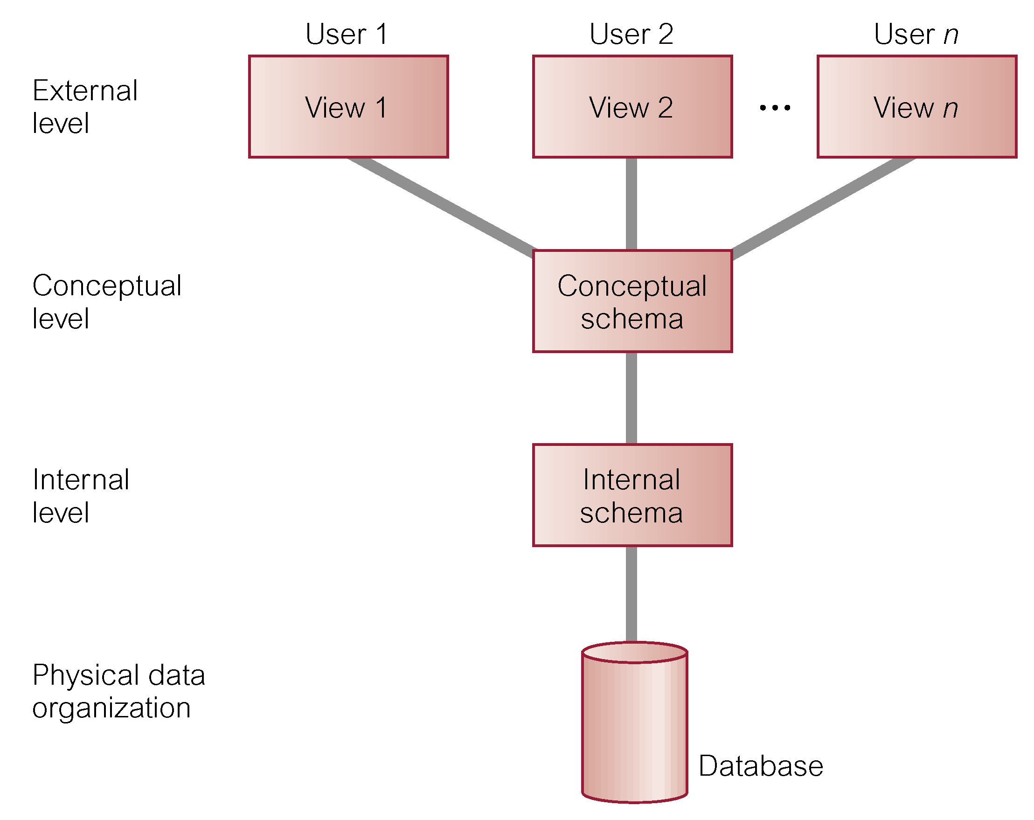
ANSI-SPARC THREE-LEVEL ARCHITECTURE
Notes:
For our purposes, the fundamental point of these and later reports is the identification
of three levels of abstraction, that is, three distinct levels at which data items can be
described

Slide 26
ANSI-SPARC THREE-LEVEL ARCHITECTURE
External Level
Users' view of the database.
Describes that part of database that is relevant to a particular user or user group and hides the rest of the database from that user group.
In addition, different views may have different representations of the same data. For example, one user may view date in the form (day, month, year).. while another may view date as (year, month, day)

Slide 27
ANSI-SPARC THREE-LEVEL ARCHITECTURE
Conceptual Level
Content view of the database.
Describes what data is stored in database and relationships among the data. It also describes the entire structure of database such as entities, attributes, data types, relationships, constraints, and user operations. It hides the details of physical storage structures.
The conceptual level is defined by means of the conceptual schema, which includes definitions of each of the various conceptual record types.
The conceptual schema is a complete description of information of database structure such as every record type with all its fields

Slide 28
ANSI-SPARC THREE-LEVEL ARCHITECTURE
Internal Level
Physical representation of the database on the computer.
Describes how the data is stored in the database. In other words, the physical representation of the database on the computer.
The Internal level is defined by means of an internal schema , which includes Description of the physical storage structure of the database

Slide 29
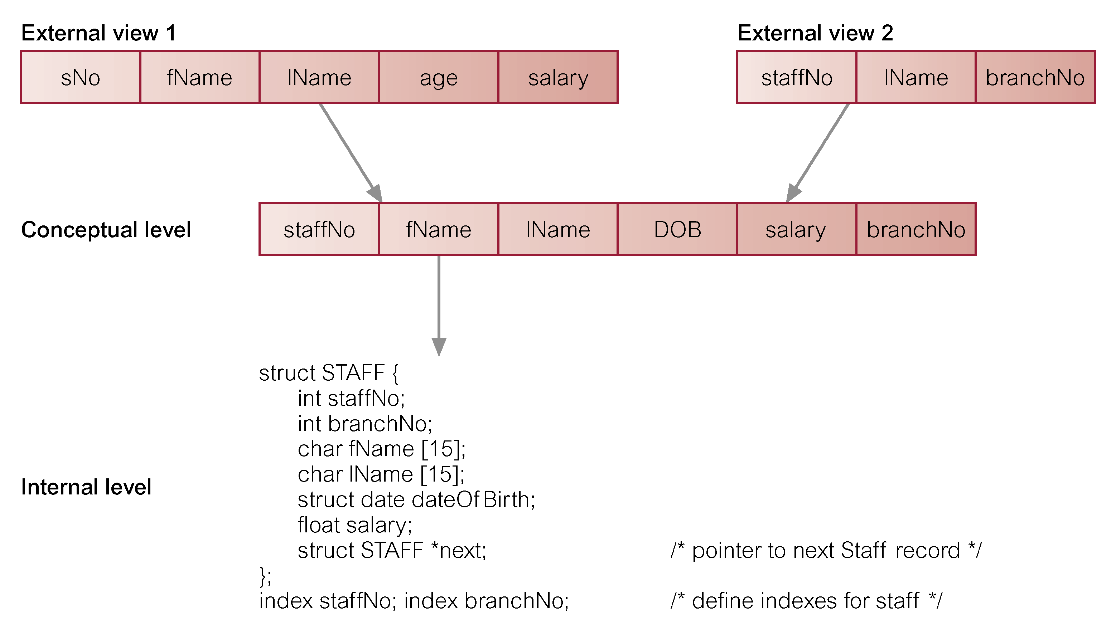
DIFFERENCES BETWEEN THREE LEVELS OF ANSI-SPARC ARCHITECTURE

Slide 30
Objective of ANSI-SPARC Architecture
To separate each user’s view of the database from the way the database is physically represented. Why?
Each user should be able to access the same data, but have a different customized view of the data
Users should not have to deal directly with physical database storage details. In other words, a user’s interaction with the database should be independent of storage considerations
The DBA should be able to change the database storage structures without affecting the users’ views.
The DBA should be able to change the conceptual structure of the database without affecting all users.

Slide 31
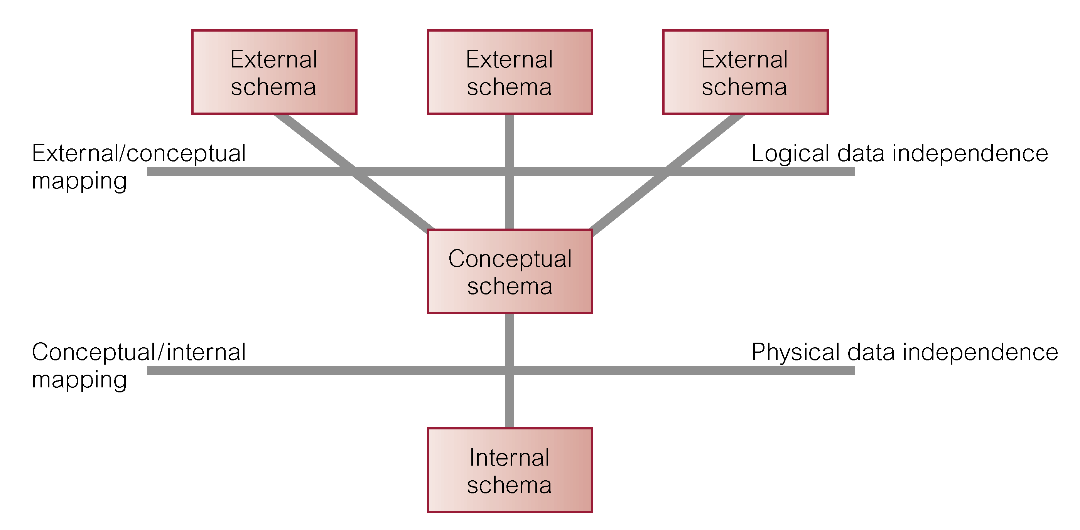
Data Independence, Mapping and the ANSI-SPARC Three-level Architecture

Slide 32
DATA INDEPENDENCE
Data Independence means that the higher levels of the database model are designed to be unaffected by changes to the lower levels. Each higher level of the data architecture is immune to changes of the next level of the architecture
There are two types of Data Independence; logical and physical
Logical data independence
Refers to immunity of external schemas to changes in conceptual schema.
Conceptual schema changes (e.g. addition/removal of entities) should not require changes to external schema or rewrites of application programs.

Slide 33
DATA INDEPENDENCE cont’d
Physical Data Independence
Refers to immunity of conceptual schema to changes in the internal schema.
Physical data independence deals with hiding the details of the storage structure from user applications.
Internal schema changes (e.g. using different file organizations, storage structures/devices) should not require change to conceptual or external schemas.

Slide 34
MAPPINGS
Mappings between the different database schemas allows for data independence. The DBMS manages these mappings and checks the schemas for consistency.
External-Conceptual mappings enable the DBMS to match names of data items etc... in the user's view with the parts of the conceptual schema that correspond to those items.
Internal-Conceptual mappings enable the DBMS to find records within the database storage medium that correspond to the logical record in the conceptual schema.

Slide 35
Lecture 1 part 3 Database System Development Life-cycle
(DSDLC)
Notes:
September 98
1
Chapter Name

Slide 36
DATABASE SYSTEM DEVELOPMENT LIFECYCLE
Consists of 11 steps which are not strictly sequential but are iterative to some extent; there are feedback loops between most stages of the lifecycle.
Database planning
System definition
Requirements collection and analysis
Database design
DBMS selection (optional)
Application design
Prototyping (optional)
Implementation
Data conversion and loading
Testing
Operational maintenance.

Slide 37
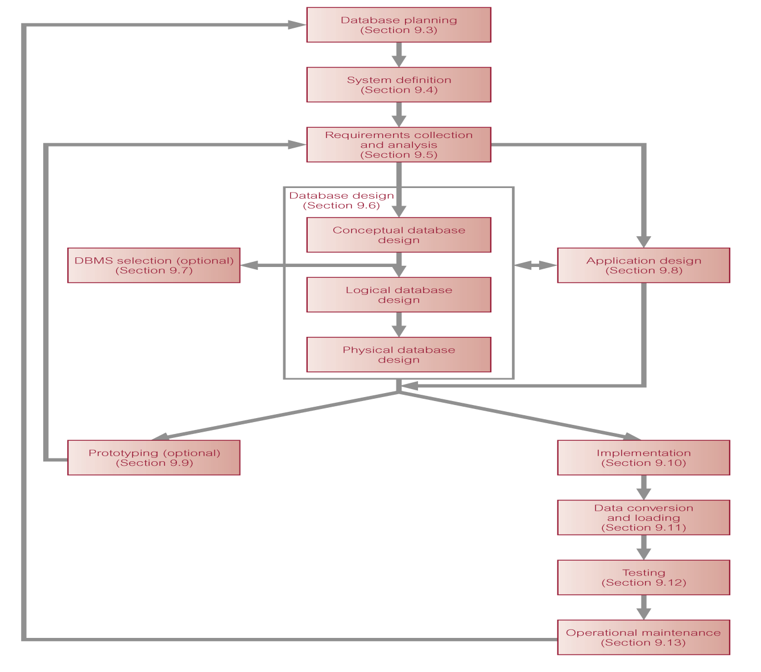

Slide 38
Step 1: Database Planning
Management activities that allow stages of database application lifecycle to be realized as efficiently and effectively, as possible.
Must be integrated with overall IS strategy of the organization.
What the database application is going to do.
To what area it will be applied.
Who will be using it.

Slide 39
Database Planning – Mission Statement
Mission statement for the database project defines major aims of database application.
Those driving database projects normally define the mission statement (director/owner).
Mission statement helps clarify purpose of the database project and provides clearer path towards the efficient and effective creation of required database application.
Example: Development of an information system that will enable the Jomayi Property Agency to manage their branches, clientele and property efficiently
Notes:
Development of a database application that will enable centralized data management of internship coordination for effeciency.

Slide 40
Database Planning – Mission Objectives
Once mission statement is defined, mission objectives are defined.
Each objective should identify a particular task that the database must support. Efficient
May be accompanied with some additional information that specifies the work to be done, the resources with which to do it, and the money to pay for it all.

Slide 41
Database Planning – Mission Objectives
Stakeholders | GoalCode | Goal
Director | G1 | To maintain (enter, update, delete) data on branches
Director/manager | G2 | To maintain data on staff
manager/supervisor/assistant | G3 | To maintain data on properties for rent
manager/supervisor/assistant | G4 | To maintain data on properties for sale
manager/supervisor/assistant | G5 | To maintain data on property owners
manager/supervisor/assistant | G6 | To maintain data on clients
manager/supervisor/assistant | G7 | To maintain data on property viewings
manager/supervisor/assistant | G8 | To maintain data on leases
Director | G9 | To perform searches on branches

Slide 42
Database Planning
Database planning should also include development of standards that govern:
how data will be collected,
how the format should be specified,
what necessary documentation will be needed,
how design and implementation should proceed.
This step is critical and provides good basis for
Staff training
Measurement of quality control.
Ensuring work conforms to given pattern irrespective of staff skills and experience
NB: takes a lot of time in terms of development and maintenance.

Slide 43
Step 2: System Definition
Describes scope and boundaries of database application and the major user views (both current and future).
It also involves describing or identifying how it interfaces with the other parts of the organization's information system.
User view defines what is required of a database application from perspective of:
a particular job role (such as Manager or Supervisor) or
enterprise application area (such as marketing, personnel, or stock control).

Slide 44
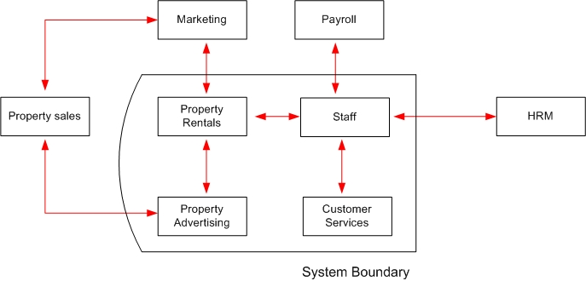
System Definition

Slide 45
System Definition
Database application may have one or more user views and each user view presents the data (what data is to be held or is needed) and transaction (what will be done with that data) requirements of a system.
Identifying user views helps ensure that no major users of the database are forgotten when developing requirements for new application (Requirement Elicitation).
User views also help in development of complex database application allowing requirements to be broken down into manageable pieces.

Slide 46
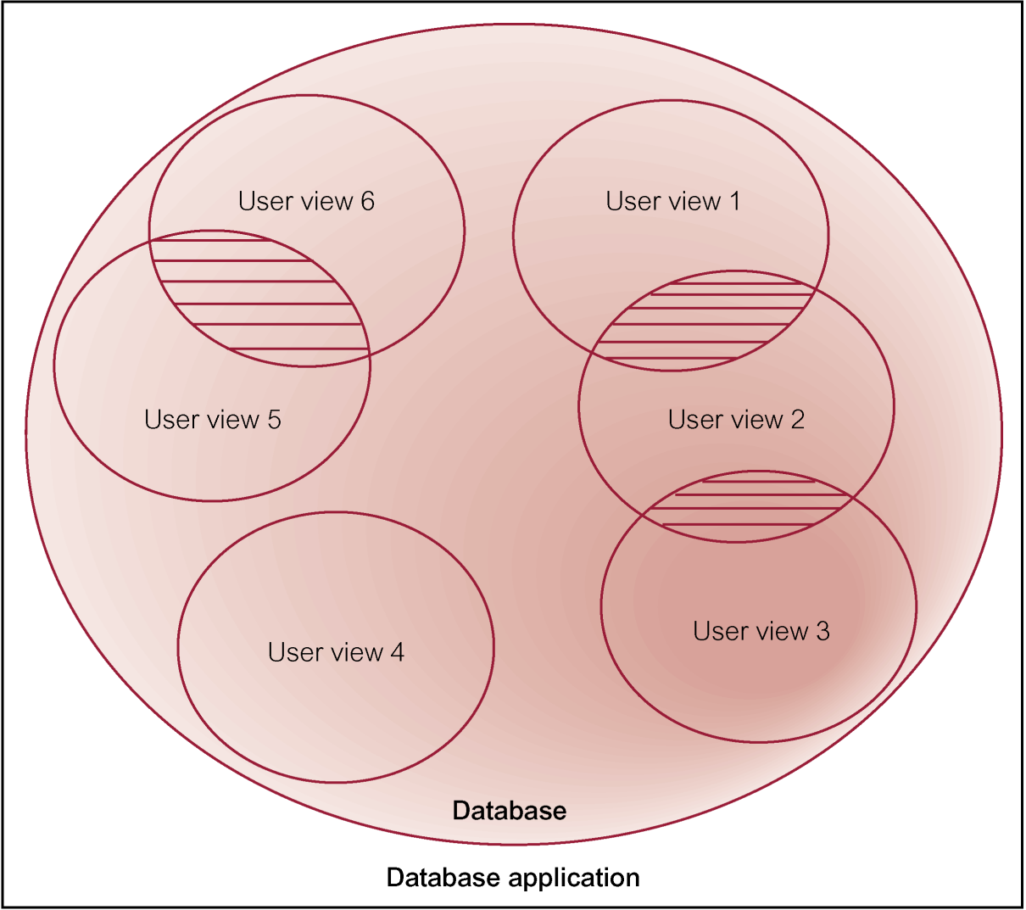
Representation of a database application with multiple user views

Slide 47
Step 3 Requirements Collection and Analysis
Process of collecting and analyzing information about the part of organization to be supported by the database system, and using this information to identify users’ requirements (Needs or wants) of new system.
At this stage, the designers efforts are focused on:
Information Users (who will use the information?)
Information needs (What kind of information is needed?)
Information Sources (Where is the information to be found and how is it to be extracted?)
Information Constitution (What data entities are needed, attributes and their relationships)
Notes:
What us requirements collection, who do we collect requirements from and how?

Slide 48
Requirements Collection and Analysis
Gathered information may be poorly structured or in form of informal requests.
Must be converted into more structured statements of requirements using requirement specification techniques such as data flow diagrams, structured analysis and Design (SAD) techniques, CASE tools; to ensure that the requirements are complete and consistent.
Information is analyzed to obtain the requirements which are stored in documents collectively known as Requirements Specification (SRS) for the new database application.

Slide 49
Requirements Collection and Analysis
Another important activity is deciding how to manage database application with multiple user views.
Three main approaches:
centralized approach
view integration approach
combination of both approaches.

Slide 50
Requirements Collection and Analysis
Centralized approach
Requirements for each user view are merged into a single set of requirements.
A global data model is created based on the merged requirements (which represents all user views).
Suitable when there is a significant overlap in requirements for each user view and the database system is not overly complex.

Slide 51
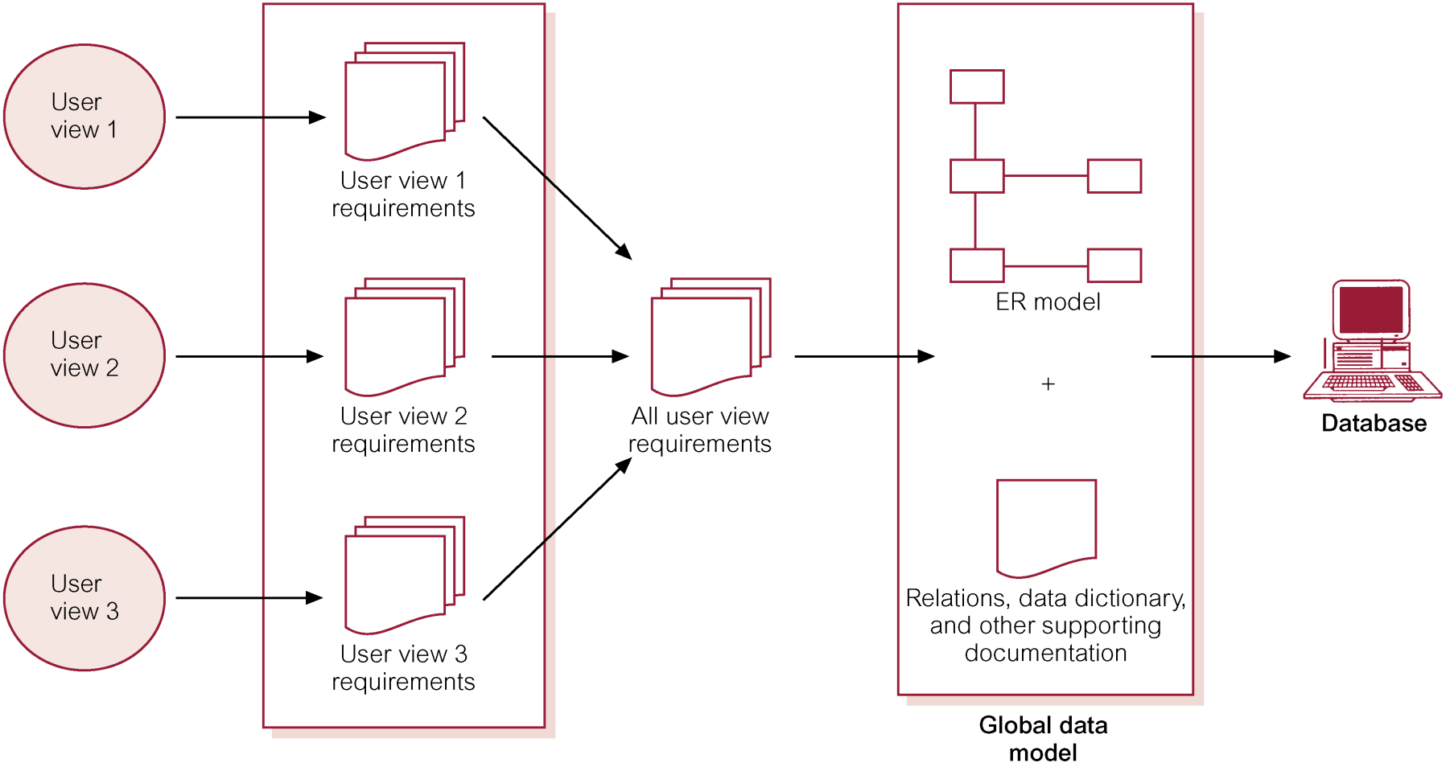
Centralized approach to managing multiple user views

Slide 52
Requirements Collection and Analysis
View integration approach
Requirements for each user view are used to build a separate data model.
Suitable when there are significant differences between the user views and the database application is sufficiently complex and requires to be broken into manageable pieces.
Data model representing single user view is called a local data model, composed of diagrams and documentation describing requirements of a particular user view of database.
Local data models are then merged to produce a global data model, which represents all user views for the database.

Slide 53
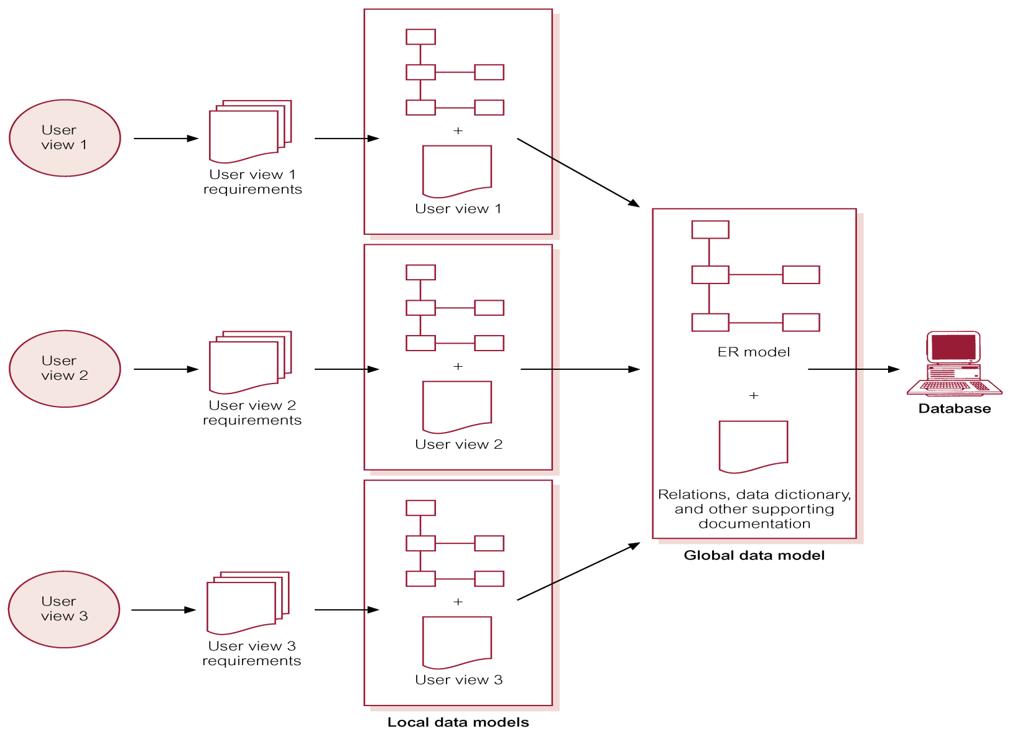
View integration approach to managing multiple user views

Slide 54
Requirements Collection and Analysis
Combination of both;
In case of overlapping requirements from different user views, a combined list of requirements is generated.
User views that have significantly different requirements are left as separate requirements lists.
The resulting requirements lists are then fed into the database design stage where the data models are built.

Slide 55
Representation of a database application with multiple user views

Slide 56
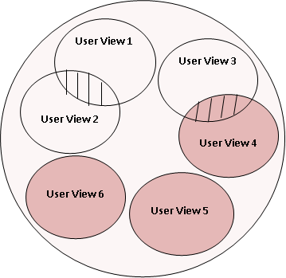
What approach wd u use?

Slide 57
STEP 4: Database Design
Process of creating a design for a database that will support the enterprise’s operations and objectives.
Major aims:
Represent data and relationships between data required by all major application areas and user groups.
Provide data model that supports any transactions required on the data.
Specify a minimal design that is appropriately structured to achieve stated performance requirements for the system (such as response times).

Slide 58
Database Design: Approaches
Top-down: Starts by developing a model containing few high-level entities and relationships, after which low level entities are identified e.g. For example the ER model.
Suitable for complex databases.
Bottom-up: Begins at a fundamental level of attributes (properties of entities and relationships).
The associations between the attributes are analyzed.
Attributes that are closely related are then grouped into relations that represent types of entities and relationships between entities.
This approach is therefore suitable for simple databases; those that have a manageable number of attributes. N.B: It is difficult to identify all the attributes for complex database and hence the functional dependencies between them

Slide 59
Database Design: Data Modeling
This is the process of building data models to represent a designer’s understanding of the information requirements of an enterprise
Main Purposes
To assist in understanding the meaning (semantics) of the data.
This involves answering questions about entities, relationships and attributes.
Answering such questions enables one to understand each user view’s perspective of the data, nature of the data itself, independent of its physical representations; and use of data across user views.

Slide 60
Database Design: Data Modeling
To facilitate communication about the information requirements.
Data models are a means by which a designer conveys his/her understanding of an enterprise’s information requirements.
Provided the two parties are familiar with the notation, these provide a basis for communication e.g. Entity Relationship Diagrams (ERD).

Slide 61
Database Design: Phases
Three phases of database design:
Conceptual database design:
Logical database design
Physical database design.
The Conceptual and logical design phases correspond to the first two levels of the ANSI-SPARC architecture of a database system.
The physical design phase provides the basis to define the internal schema.

Slide 62
Conceptual Database Design
Process of constructing a model of the information used in an enterprise, independent of all physical considerations, such as; target DBMS software, Application program, Programming language and Hardware platform.
Data model is built using the information in users’ requirements specification and is tested and validated against the user requirements.
Output of this phase is the source of information (input) for logical design phase.

Slide 63
Conceptual Database Design
Steps to building conceptual data model
Identify entity types and relationship types
Identify and associate attributes with entity or relationship types
Determine attribute domains
Consider use of enhanced modelling concepts(opt)
Check model for redundancy
Validate conceptual model against user transactions
Review conceptual data model with user

Slide 64
Logical Database Design
Process of constructing a model of the information used in an enterprise based on a specific data model (e.g. relational), but independent of a particular DBMS and other physical considerations.
This means that the data model is built knowing the underlying data model of the target database management system e.g. the DBMS may be relational, hierarchical, network or object oriented.
Conceptual data model is refined and mapped on to a logical data model e.g. Relational model.

Slide 65
Logical Database Design
The model is also tested and validated against user requirements.
The correctness of the data model (relational) is tested using a technique known as normalization which ensures that the relations derived from the data model have no data redundancy displayed.
The logical data model should also be examined to ensure that it supports all the transactions specified by the users.

Slide 66
Logical Database Design
Steps to building and validating logical data model
Derive relations for logical data model
Validate relations using normalization
Validate relations against user transactions
Check integrity constraints
Review logical data model with user
Merge local data models into global model(opt)
Check for future growth

Slide 67
Physical Database Design
Process of producing a description of the database implementation on secondary storage.
The physical database design deals with the how while the logical and conceptual design deal with the what.
The physical database design is therefore a description of how the logical database design (logical data model) will be implemented.

Slide 68
Physical Design Cont’d
In physical database design the logical schema is transformed to suit a specific database management system and choices are made on the following:
Data types
Data range constraints
Requirement rules
Default values
Cascading rules
Representation of derived attributes
These decisions are placed in a data dictionary and are some times referred to as meta data.
Developers use the data from the data dictionary to create the tables of the database application.

Slide 69
Physical Design Cont’d
Note:
A highly normalized database is free from data redundancy, but may be slow due to the many joins that have to be made when querying it.
In the interest of speed, some denormalization may have to be made so as to reduce the number of joins that are to be made when the system is operational.
Denormalization may occur before system implementation when the system is operational and reported to be slow.
Either way a database needs fine-tuning in order to speed up its operations.

Slide 70
Database Design Conclusion
The importance of database design phase includes;
Definition of the user views
Maintenance of data integrity
Maintenance of acceptable performance
It is an iterative process with a starting point, and an almost endless procession of refinement.
It is a process for designers to understand the workings of an enterprise and meaning of its data, and to correctly present its information requirements in a data model.
New information gained may require changes in other parts of the design

Slide 71
Step 5: DBMS Selection (optional)
Selection of an appropriate DBMS to support the database application.
This is done at any time prior to the Logical database design phase provided there is sufficient information regarding the systems requirements e.g. performance, security and integrity constraints.

Slide 72
DBMS Selection
The DBMS selection process must cater for the enterprise’s current and future requirements, at an optimum cost (purchase of the DBMS, additional hardware/software, changeover costs and staff training) as there may be need to expand or replace the system.
Main steps to selecting a DBMS:
Define terms of reference of study
Shortlist two or three products
Evaluate products
Recommend selection and produce report.

Slide 73
STEP 6: Application Design
Design of user interface and application programs that use and process the database.
Database and application design are parallel activities, since a database exists to support applications.
Includes two important activities:
transaction design
user interface design.

Slide 74
Application Design: Transactions
This involves designing the application programs that access the database and the transactions (access methods).
This design provides a description of how the functionality of the database application will be achieved.
A transaction is an action, or series of actions, carried out by a single user or application program, which accesses or changes content of the database, for example, cash withdrawal, cash deposit, etc

Slide 75
Application Design: Transactions
Three main types of transactions: retrieval, update and mixed.
Retrieval; these are used to retrieve data from a database and display it on the screen. They are used for reporting purposes.
Update; these are used to insert new records, deleting old records and modifying existing records in the database.
Mixed; these are used for retrieval and updating of data in a database.

Slide 76
Application Design: Transactions
The purpose of the transaction design is to define and document the high-level characteristics of the transactions required
Important characteristics of transactions:
data to be used by the transaction
functional characteristics of the transaction
output of the transaction
importance to the users
expected rate of usage.

Slide 77
Application design: User Interface
This involves designing a user-friendly user interface to the database application.
The user interface that is designed should be easy to learn, simple to use, intuitive and forgiving among other characteristics.
This is an important activity because it usually determines the acceptability of the database application by the users.

Slide 78
Step 7: Prototyping (optional)
It involves building a working model of a database application.
It does not have all the required features functionality.
Purpose
to identify features of a system that work well, or are inadequate
to suggest improvements or even new features
to clarify the users’ requirements
to evaluate feasibility of a particular system design.

Slide 79
Prototyping: Strategies
Requirements prototyping;
This is the use of a prototype to determine the requirements of the proposed database application. Once the requirements are complete, the prototype is discarded.
Evolutionary prototyping;
In this strategy, the prototype is also used to determine the database application’s requirements. Once they’ve been identified, the prototype is refined into the fully functional/working database application.

Slide 80
Step 8: Implementation
Physical realization of the database and application designs.
Database implementation is achieved using the data definition language (DDL) of the selected DBMS;
Creation of database schemas, empty relational schemas, and any specified user views.
Application programs and database transactions are developed using a programming language, and the DML possibly embedded in the host programming language respectively.
Security and integrity controls and the other database application components such as forms, menu screens and reports are also implemented in this stage.

Slide 81
Step 9: Data Conversion and Loading
Transferring any existing data into new database and converting any existing applications to run on new database.
Only required when new database system is replacing an old system.
DBMS normally has utility that loads existing files into new database.
May be possible to convert and use application programs from old system for use by new system.

Slide 82
Step 10: Testing
Process of executing application programs with intent of finding errors.
Use carefully planned test strategies and realistic data.
Testing cannot show absence of faults; it can show only that software faults are present.
Demonstrates that database and application programs appear to be working according to requirements.
Important to include users at this stage.

Slide 83
Step 11: Operational Maintenance
Process of monitoring and maintaining system following installation.
Monitoring performance of system.
if performance falls, may require tuning or reorganization of the database.
Maintaining and upgrading database application (when required).
Incorporating new requirements into database application.

Slide 84
Operational Maintenance
The new system and old one should operate in parallel for a while to safeguard against unanticipated problems with the new one.
Periodic checks on data consistency between the two systems need to be made, and only when the two appear to be producing the same results, should the old one be dropped.

